Slide 1



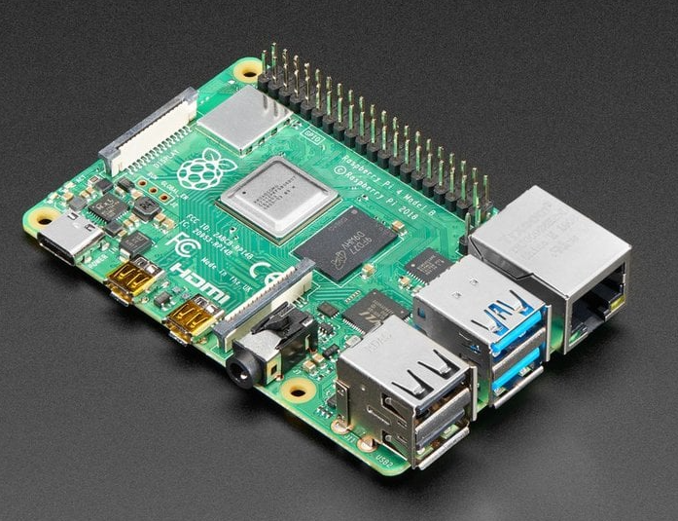
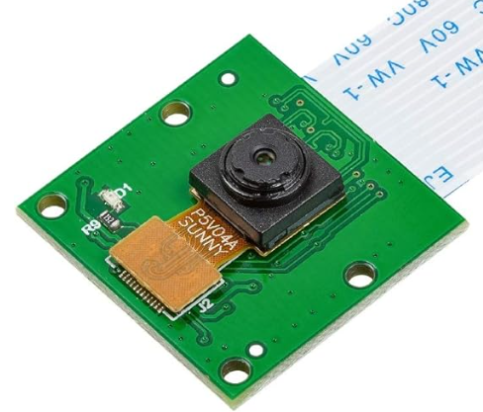
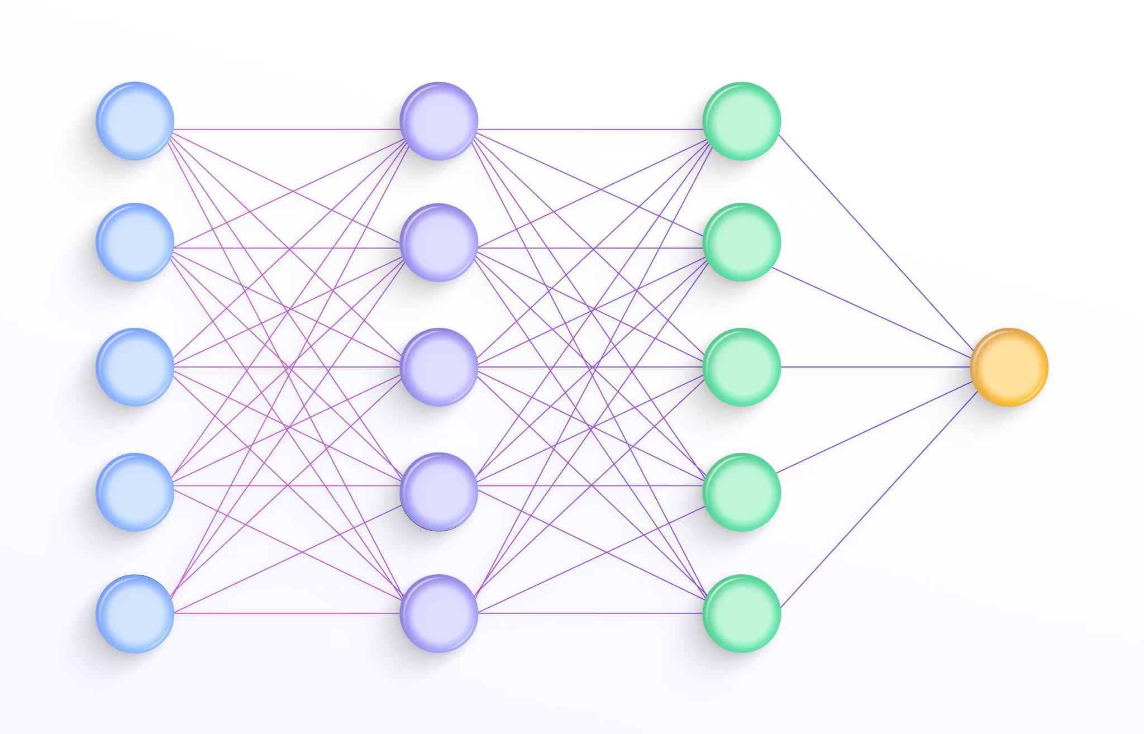


Facial recognition Door camera
ECE 196 Spring 2024
Matt, Jean,Yuktha
Problem Statement
People with amnesia struggle to remember a lot of their personal information including their identity, other people’s identities, location of belongings, etc. It severely disrupts their everyday lives and is harder especially when they have to be independent.
Our Solution
Testable Hypothesis
Proposed Idea: Door Camera with Facial Recog.
Hypothesis: Users who experience amnesia who use our facial recognition door camera experience a higher level of confidence when answering the door as opposed to without one.
Measurement: Noting whether or not the person with amnesia is capable of recalling the person of the door with the assistance of the phone application
Design
Send to Rasp. Pi
Via Telegram API
Train neural net using Rasp. Pi
Upload algorithm
Take photos of Robert’s face using smartphone
Use proximity sensor PCB to activate camera
Send to smartphone
Via Telegram API
Robert is at your front door
Robert is identified at door
Proposed Workshop
Prototype
Test Results

